Slide 1
Asian Games
Group 5
Debasish Rath
Subham B
Supriya SK
Sachin Mathew

Slide 2
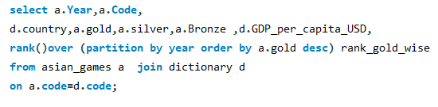
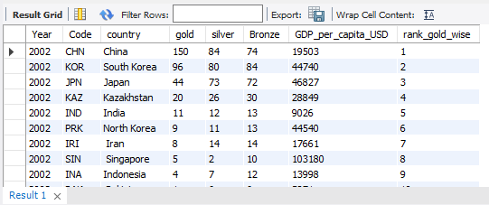
RANK()OVER (PARTITION BY expr,...
ORDER BY expr [ASC|DESC],...)
RANK()
Syntax:
Q1- Show the rank of all country on the basis of Gold medals, Year wise
Methods used:
Rank(Window function)
Inner join

Slide 3
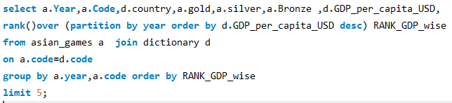
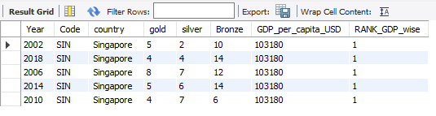
Q2- Show the top performing country GDP wise per year
Methods used:
Rank(Window function)
Inner join
Group by
Limit

Slide 4
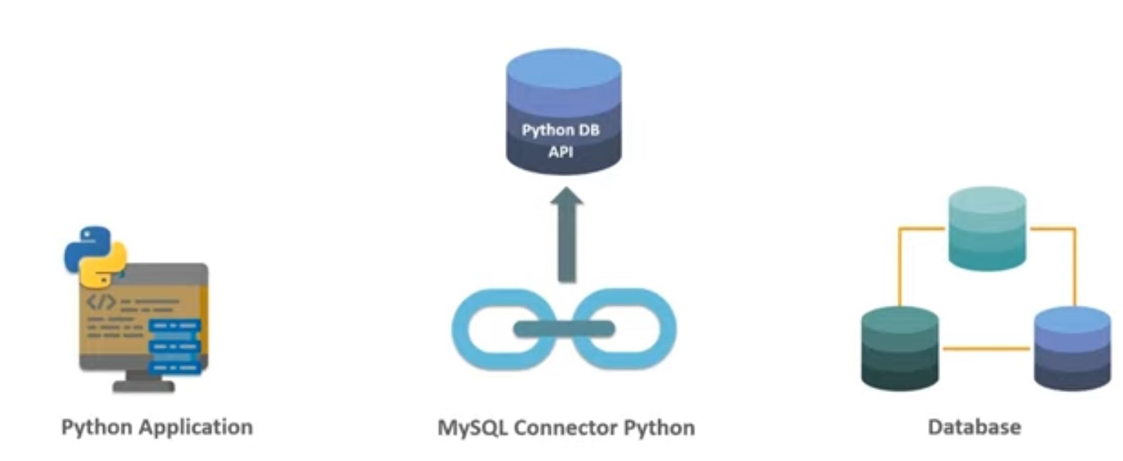
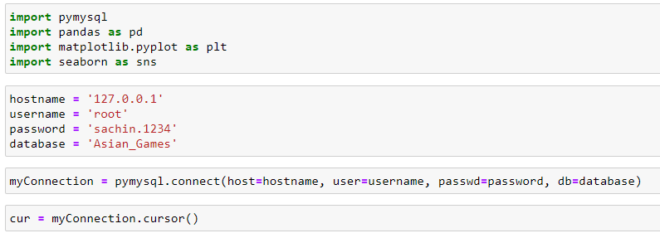
PYTHON CONNECTIVITY WITH SQL

Slide 5
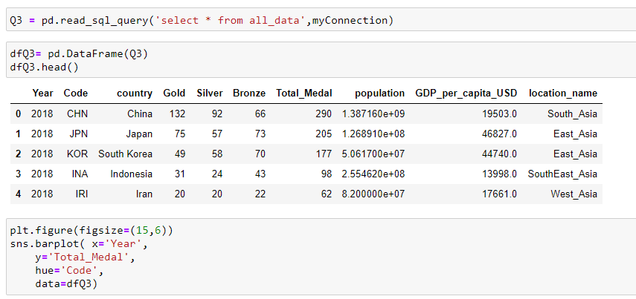
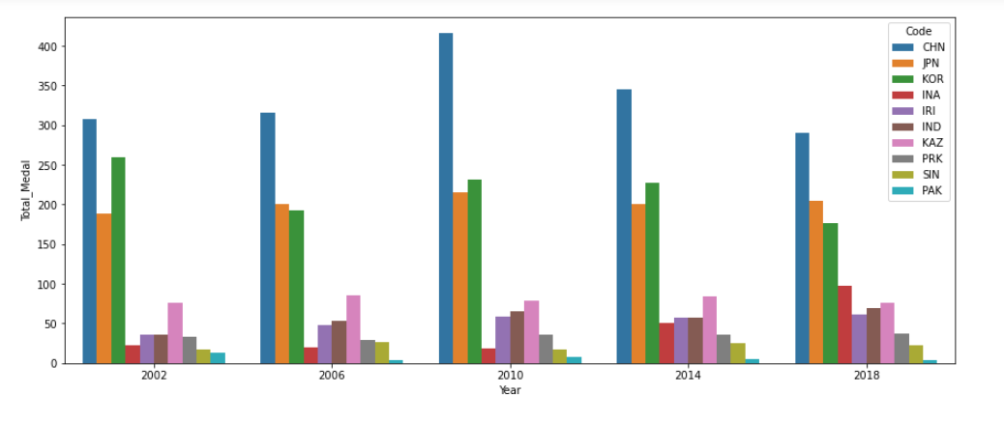
Q3- Distribution of Total Medals Per country through out the years

Slide 6
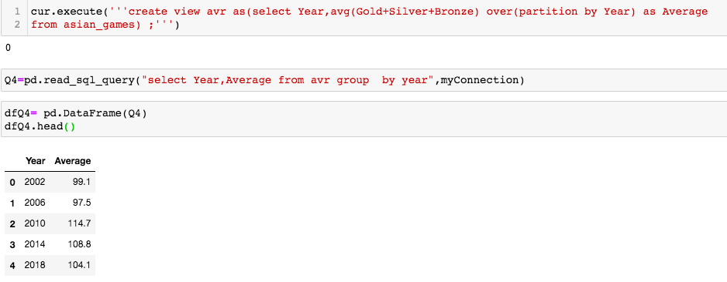
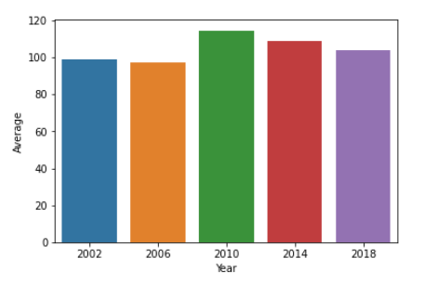
Q4- Average medals won by all the countries over a span of 5 Year

Slide 7
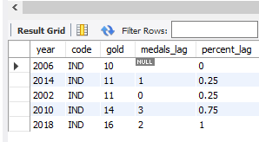
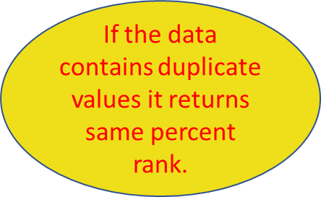
PERCENT_RANK( )
Syntax:
For a specified row percent_rank( ) is given by:
Percent_rank( ) on duplicate values
PERCENT_RANK()OVER (PARTITION BY expr,...
ORDER BY expr [ASC|DESC],...)
(rank - 1) / (total_rows - 1)

Slide 8
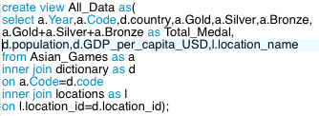
Q5- Percent rank on total gold medals won by each country, gdp and population
Create a virtual table visualisation using
for Population and GDP matplotlib
Apply percent_rank( )
Create a view of Population and
GDP per Capita

Slide 9
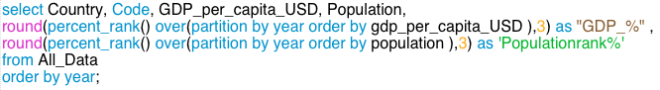
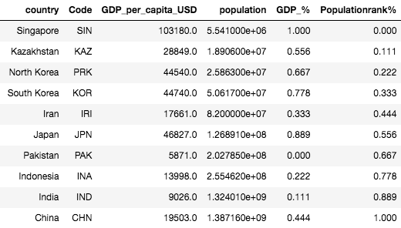
Percent_rank( ) on created view
Partition by is used to categorise records according to the year.

Slide 10
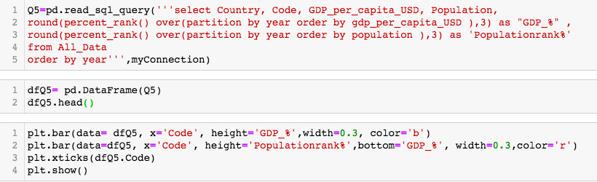
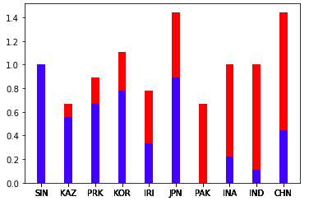
Visualisation using matplotlib

Slide 11
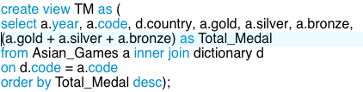
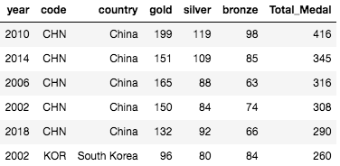
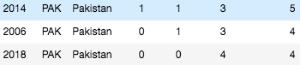
Q6- Percent rank on total medals over the period of 5 years
Create view on total medals won
by each country

Slide 12
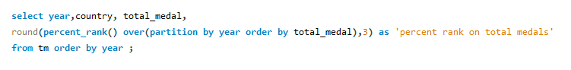
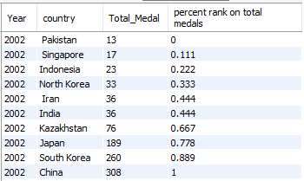
Percent_rank( ) on created view

Slide 13
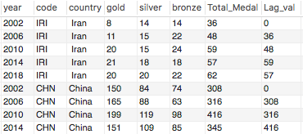
LAG( ) SYNTAX:
LAG(return_value ,offset [,default]) OVER ( [PARTITION BY partition_expression, ... ] ORDER BY sort_expression [ASC | DESC], ... )

Slide 14
Q7- Find increase and decrease in the no of medals won by India.
Create a virtual table for applying the lag function
Visualization
Finding the difference

Slide 15
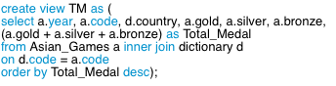
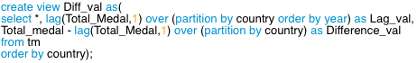
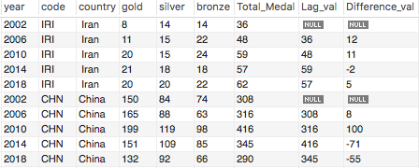
Create a virtual table for applying the lag function
Finding the difference

Slide 16
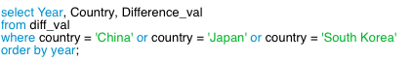
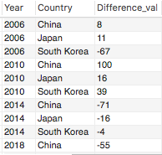
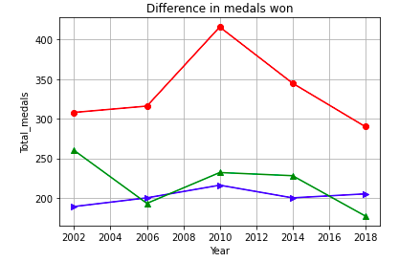
Visualization

Slide 17
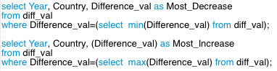
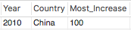
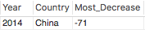
Q8. Which country faced the most increase and most decrease in the no of medals won?

Slide 18
Thank You ☺

